Slide 1


Slide 2

Decentralized Credit Score System
Final Year project II Presentation

Slide 3
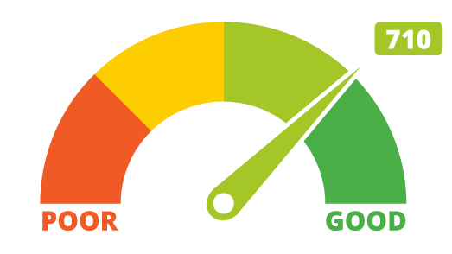
DECENTRALIZD CREDIT SCORE SYSTEM
Supervisor: Dr. Asif Raza Shah
Team Members:
Arslan Ali
Muhammad Muzammil Raza

Slide 4
Presentation Outline
Introduction
Problem Statement
Literature Review
Our Solution
Why Blockchain?
Implementation
Tools and Techniques
Results
Conclusion & Future Work
Demonstration
Architecture of our system

Slide 5
Introduction
Our final year project is web application using Blockchain technology named “DECENTRALIZD CREDIT SCORE SYSTEM”.
The aim of this project is to increase landing services
It is B2B application, used to calculate the credit score, issuing the loan on the behalf of individual credit score

Slide 6
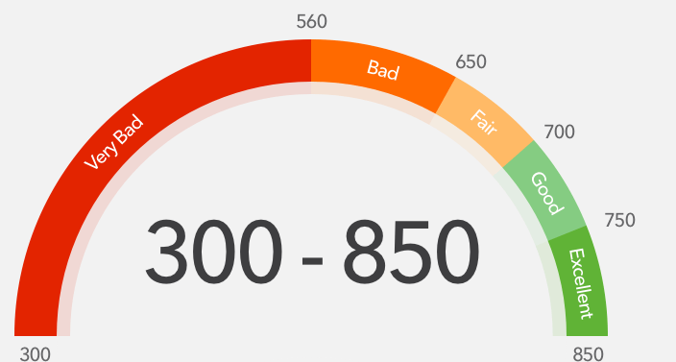
What is credit score?
Credit Score is numeric score, which describes the credit-worthiness of individual.
“Credit Score” is consider very important factor for borrower while requesting for loan from any financial organization.

Slide 7
Problem Identification

Slide 8
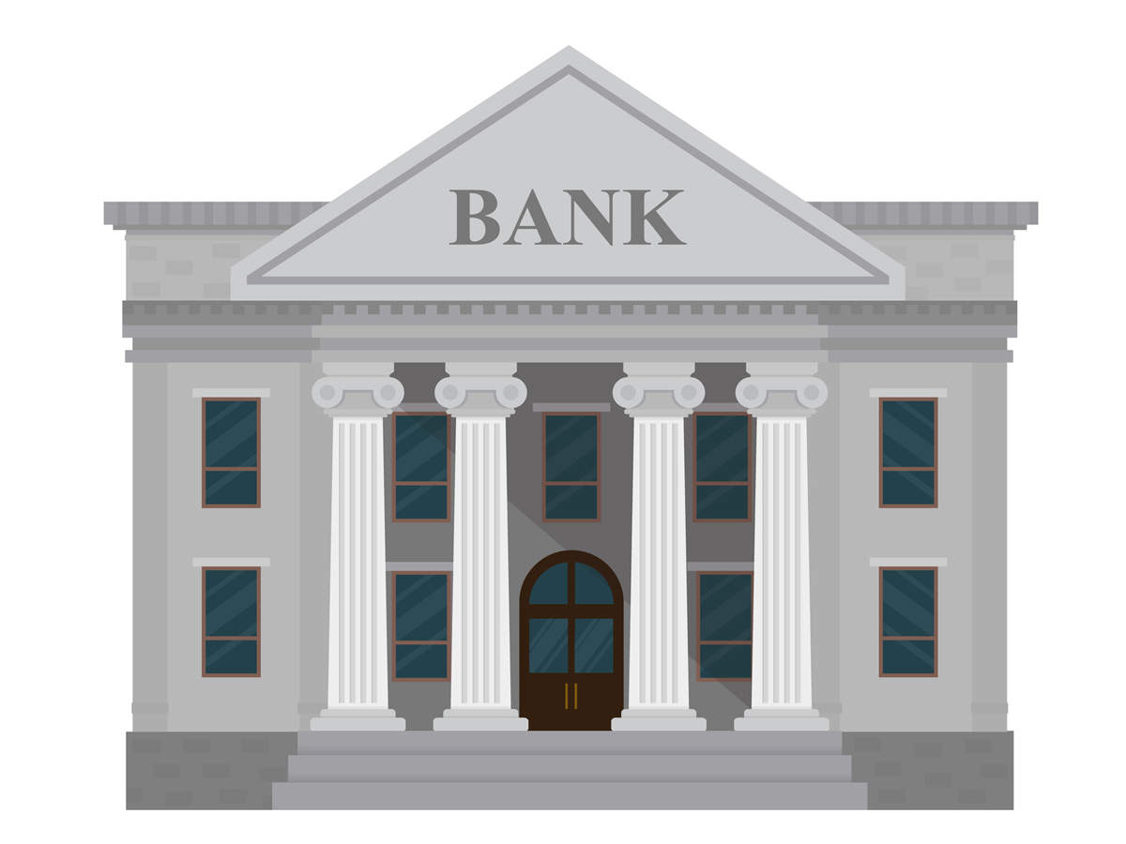


Traditional Credit Scoring System
requesting to calculate the credit score
Customer
Bank
Credit Bureau
credit score

Slide 9
Traditional Credit Scoring System (Issues)
Centralized system
Bank dependent on credit bureau
Credit bureau may provide false information
Not updated Information
Security issue

Slide 10
Literature Review
Centralized System
Don’t know who is changing the record
False Record
Can be hacked

Slide 11
Equifax
Equifax Centralized System
In September of 2017, Equifax data breach.
Exposed the personal information of 147 million people
one of the prominent credit agency of USA
Settlement amount includes up to $425 million to help people affected by the data breach.
Loss of Trust

Slide 12
Literature Review
Bloom (Blockchain)
Credit Agency
Pave (Blockchain)
Credit Agency
Credit Agency
Micro Money (Neural Networks + ML + Big Data + Blockchain)
To calculating the credit score

Slide 13

Solution: Decentralized Credit Score System
Decentralized system using blockchain technology
Banks will be independent
Create trustless environment
Calculate credit score
System will become more secure
Immutability

Slide 14
Why Blockchain?
Transparency of data
Banks become independent
Eliminate the third party
Create trust between Banks
Trustless environment

Slide 15

Blockchain Implementation Using Hyperledger Fabric

Slide 16
What is Hyperledger Fabric ?
Hyperledger Fabric is an open source project from the Linux Foundation blockchain framework. Fabric implementation for private and permissioned business networks, where the member identities and roles are known to each other members. It’s designed as a foundation for developing solutions with a modular architecture. It allows components, such as ledger, consensus mechanism, and membership services, to be plug-and-play. It leverages container technology and delivers enterprise-ready network security, scalability, and confidentiality.

Slide 17
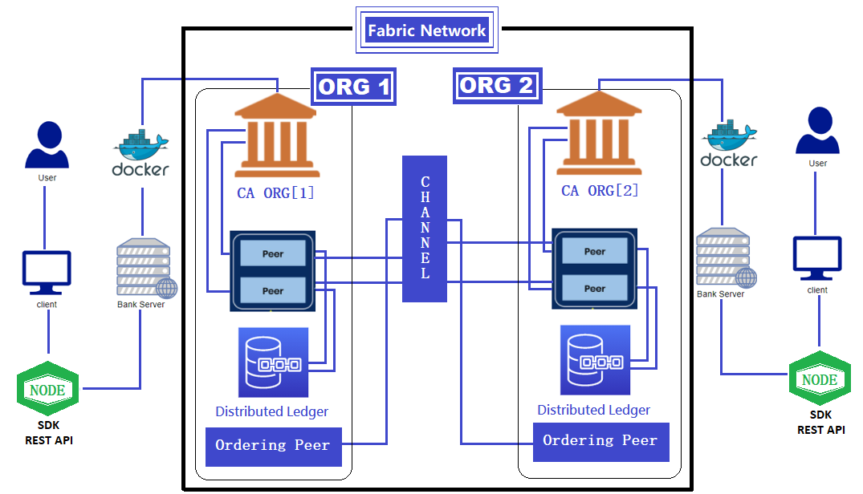
Architecture Hyperledger Fabric

Slide 18
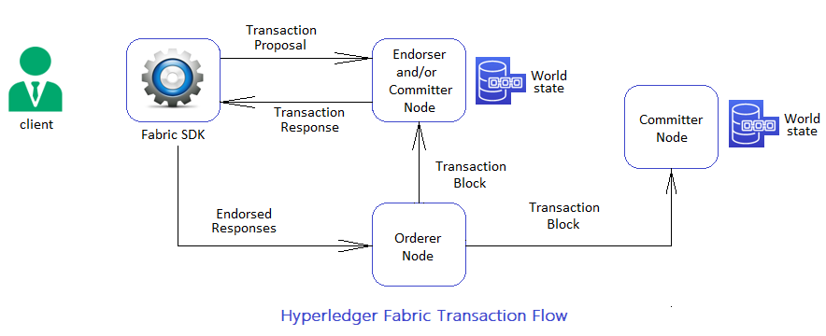
Transaction Flow Diagram Hyperledger Fabric
1
2
4
3
5

Slide 19
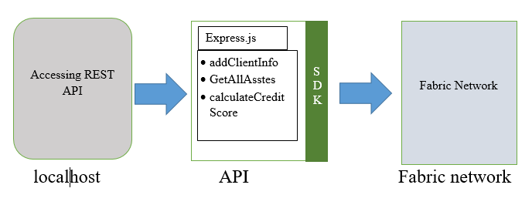
Architecture
Hyperledger Fabric
Blockchain network

Slide 20
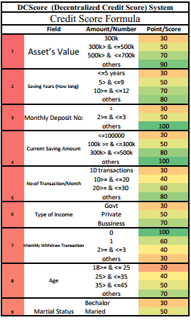
Credit Score Parameter

Slide 21
Tools used?
Docker container,
compose
Hyperledger Fabric
Go Language (smart Contract)
Node.js
REST architecture
Bootstrap

Slide 22
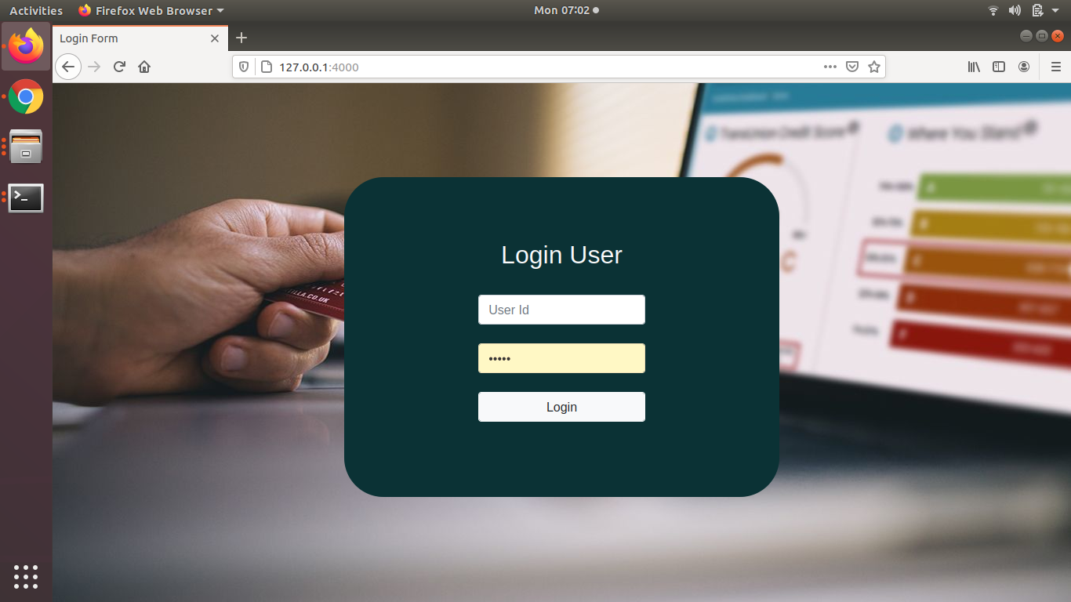
Results

Slide 23
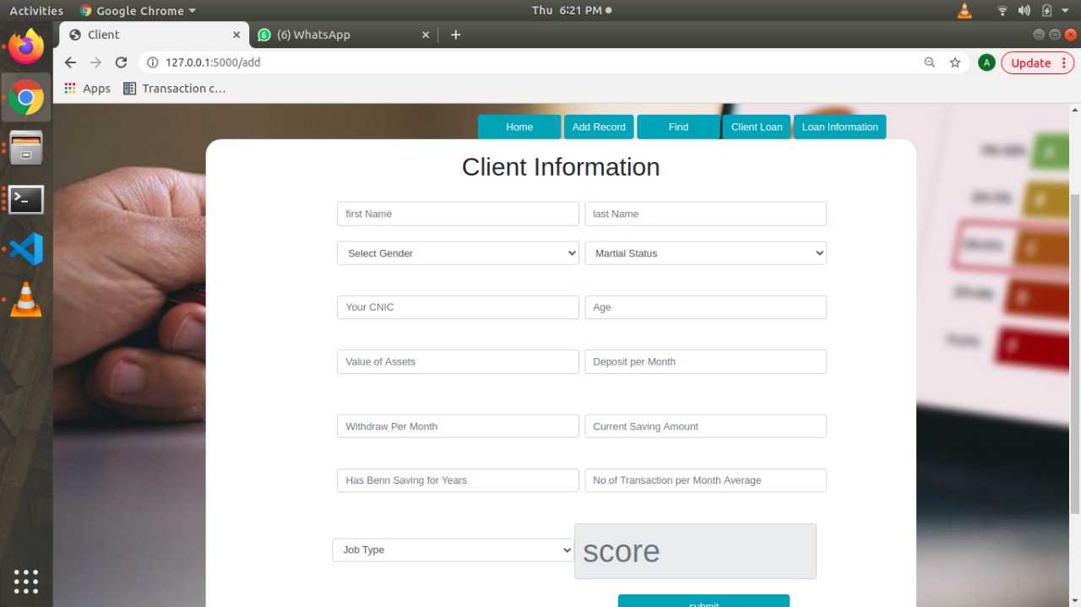
Results

Slide 24
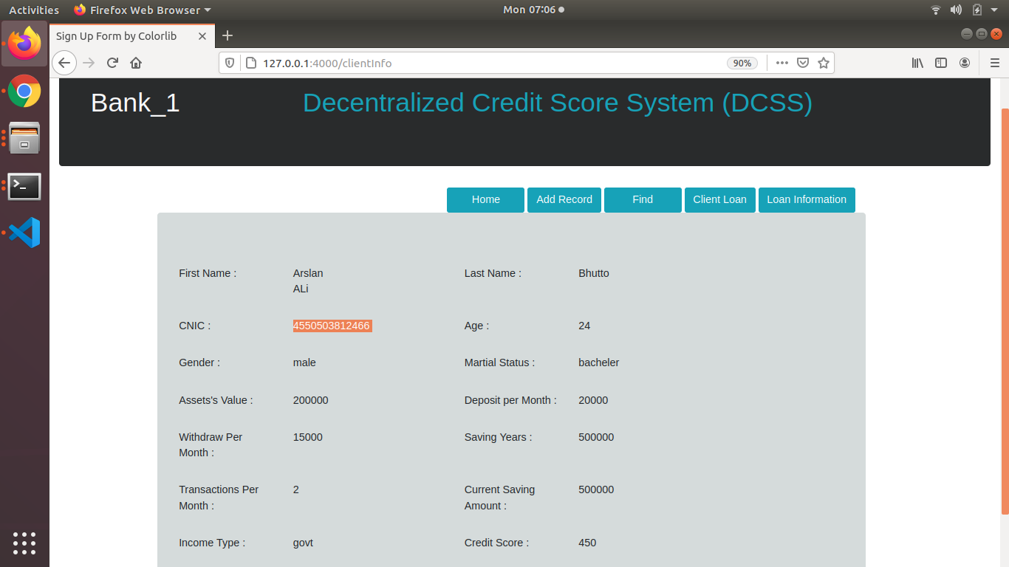
Results

Slide 25
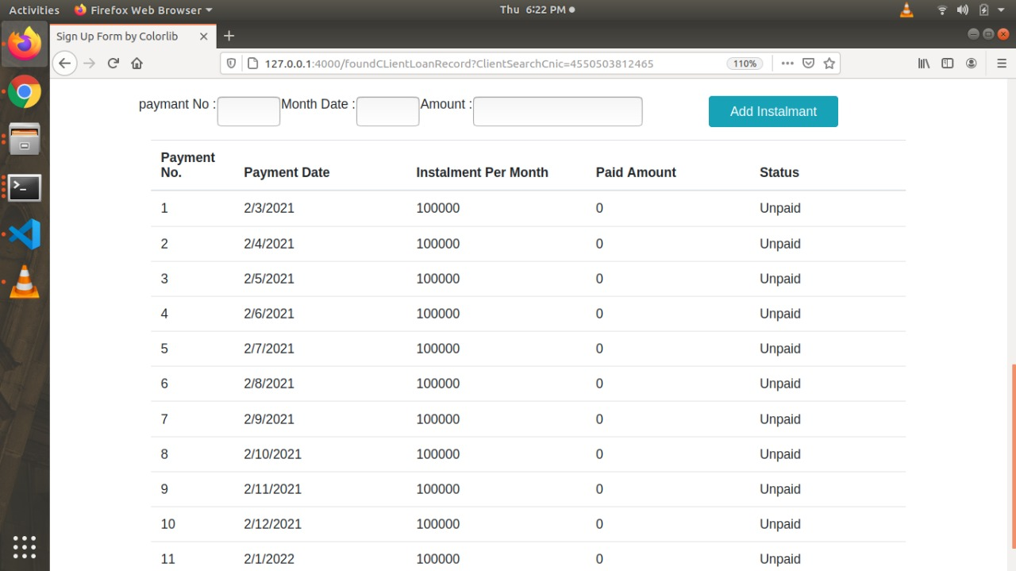

Slide 26
Conclusion & Future Work
Conclusion
Now Bank can easily share data with other Bank
Eliminate third party like (Credit Bureau)
Provide transparency, immutability of data
Future Work
Participate multiple organization
Client can apply for multiple types of loan
Can use AI to calculate the credit score

Slide 27
Project Demonstration

